Slide 1
Innodatatics
AI-Driven Intelligent IT Operations Platform
CAPSTONE PROJECT · ISB AMPBA B23W
Team Members:
Abhinav Paul
12420055
Abhishek Sampath
12420011
Anjali Mishra
12420016
Deepankar Garg
12420012
Krishna Ranjan
12420014
Faculty Mentor:
Prof. Sumanta Singha

Slide 2
Agenda
Project Overview
Architecture
01
02
Reactive IT ops — 4 failure modes driving business risk
Seven-stage AI pipeline · 4 integrated ML modules
Exploratory Data Analysis
Ticket Intelligence Engine
03
04
9 datasets · 135K+ records · 4 key insights
NLP classification · Retrieval · AHP routing
SLA Breach Governance
Predictive Maintenance
05
06
CatBoost · 94.7% recall · 4-tier escalation
RSF · C-Index 98.90% · 5-stage feature cascade
Procurement Optimization
Dashboard
07
08
Demand-driven reorder algorithm
Login · 5 modules · Role-based · Live screenshots
Results & Future Scope
Key Takeaways
09
10
Business impact · Scalability roadmap
6 lessons from building end-to-end AI ops
OpsIntel · ISB AMPBA 2025W · Innodatatics

Slide 3











Project Overview
PROBLEM STATEMENT
PROJECT OBJECTIVES
IT ops are critical across BFSI, healthcare, manufacturing & IT services — but managed through fragmented, siloed systems.
AI-Driven IT Operations Platform
Predictive. Automated. Intelligent.
01
Automate Service Ops
Reactive Service Management
Retrospective SLA
Reduce manual ticket handling, improve response time
Responding only after incidents occur — no early warning capability
SLA monitoring is backward-looking with limited breach prevention
02
Proactive SLA Governance
Unpredictable Failures
Experience-Based Inventory
Predict breach risks, take preventive action
Hardware failures surprise teams due to lack of predictive insights
Procurement decisions driven by gut feel, not data
03
Predictive Maintenance
Anticipate hardware failures, cut unplanned downtime
BUSINESS IMPACT
04
Optimize Inventory
Increased
Downtime
SLA Penalties
& Cost Overruns
Inefficient
Resource Use
Service
Disruptions
Align stock with demand, reduce costs and stockout risk

Slide 4
Architecture

Slide 5
Architecture
Expected Time Spent: 1 w
Actual Time Spent: 1 w
High Level System Architecture
SENSE
( Data Source )
Services Tickets
Asset Manager
PROCESS
( Data Processing and Feature Layer )
Data Cleaning
Data Processing
PREDICT
( AI and ML Modules )
Hardware maintenance
NLP Ticket Classification
COORDINATE
( Optimization Algorithm )
DECIDE
( Decision Engine )
ACT
( Actions taken )
LEARN
( Monitoring and Reinforced Learning : Human in Loop )
Engineer Master
Hardware Telemetry
Maintenance History
Client Master
Inventory History
Feature Engineering
Ticket Knowledge Base / Historical Ticket Repository
SLA breach
Failure Prediction - Time series Ensemble Model
Classification Model
Hardware Optimization
Unconstraint Procurement Recommendations
Failure Prediction based Maintenance schedule
Recommendation Engine
SLA Breach
Spare Part and Assets Demand Forecast
Resolution Time Analysis
Service Tier Impact
Allocation optimization
Breach Time Prediction
Decision Thresholds
Business Policy
SLA Breach Thresholds
Employee Specialization
Final Decision
Ticket Routing
Suggested Engineer Group
Constraint Procurement Recommendations
Operational Governance
Preventive Maintenance
Spare Parts and Assets Procurement Ordering
Preventive Maintenance schedule
Engineer Assignment and Ticket Solutioning
KPI Reporting
Model Performance Monitoring
Procurement Analytics
Ticket Resolution Time
SLA Compliance Rate
Infrastructure Downtime
Prediction Accuracy
Failure Prediction Accuracy
Ordering Size
Current Inventory Levels
Service tickets
Resolution notes
Asset / issue metadata
Category Classification
Priority Classification
Ticket Understanding
TF-IDF Vectorization
Cosine Similarity Retrieval
Rule-Based Ranking
Recommended Resolution
Assign Recommended Engineer / Group
Apply Suggested Resolution
Update Ticket Workflow
2L Approval
2L Approval
2L Approval
Operational Data → Data Processing → AI Models → Decision Engine → Execution Layer → Monitoring and Learning

Slide 6
Exploratory Data Analysis

Slide 7
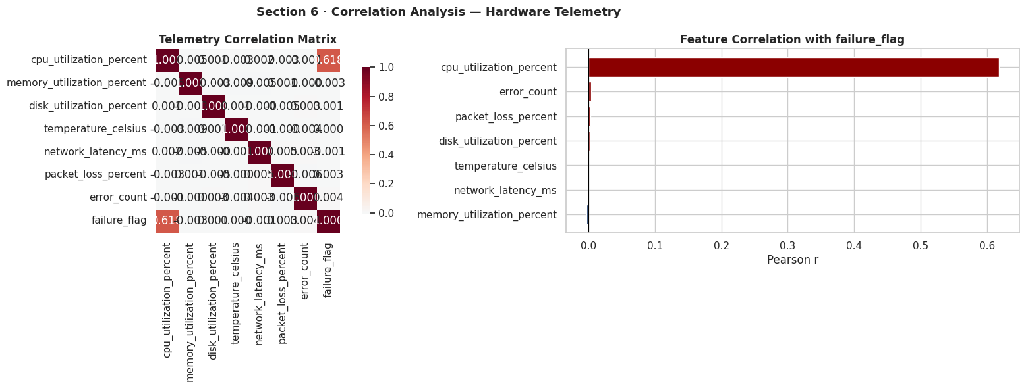
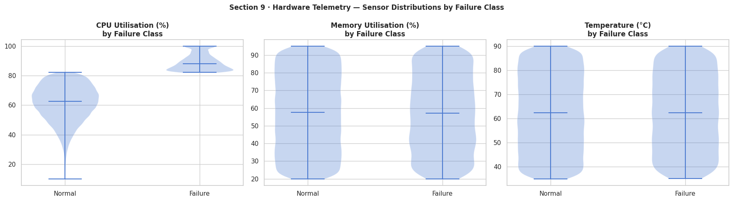
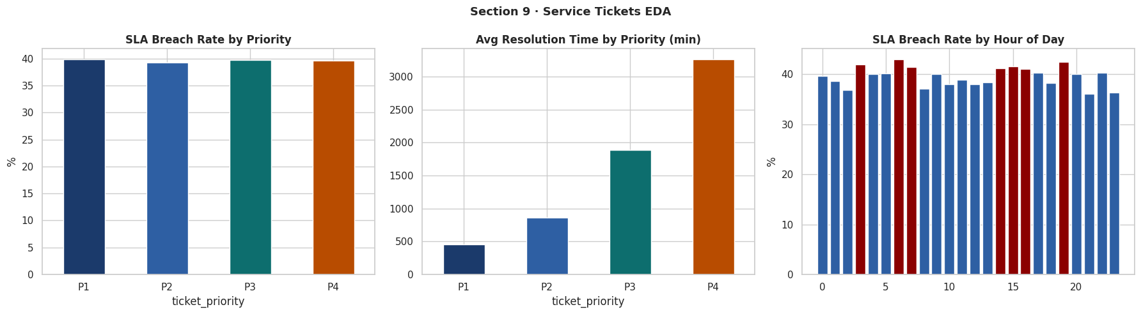
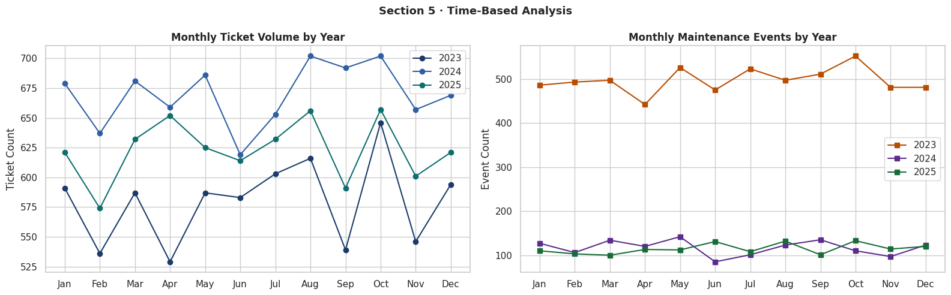
Exploratory Data Analysis — Key Insights
9 Datasets | 135K+ Records
1
CPU Is the Dominant Failure Signal (r = 0.62)
2
Hard Failure Threshold at 82% CPU
All other sensors show near-zero correlation with failure. CPU alone explains ~38% of failure variance. Memory, disk, temperature, network — all noise in a linear context.
Normal ops: 61.5% avg (std 12.3). Failure: 89.3% avg (std 5.4). Min CPU at failure = 82.2%. Pattern is uniform across all device types and criticality levels.
3
SLA Breach Rate Systemic at ~40%
4
Ticket Volume Growing 15–20% YoY
P1: 39.8%, P2: 39.3%, P3: 39.7%, P4: 39.6%. Flat across all years and clients (36–43%). Resolution time scales correctly (P1: 457 min → P4: 3,261 min) — the issue is capacity, not execution.
Steady climb 2023→2025 with no seasonal spikes. Failure events follow same trend. System is keeping pace but not improving — flat breach rate despite proportional scaling.

Slide 8
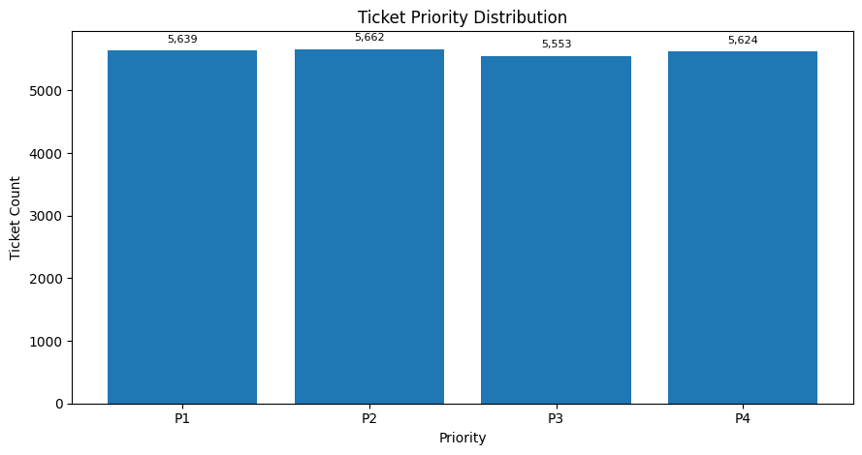
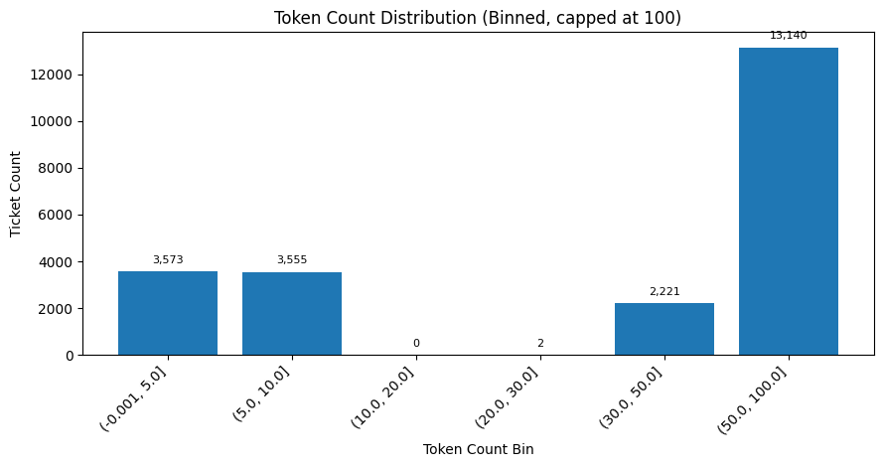
EDA
Expected Time Spent: 1 w
Actual Time Spent: 1 w
Class Balance Enables Classification While Sparse Text Constrains NLP
CLASSIFICATION TARGET ANALYSIS
NLP TEXT SIGNAL QUALITY
Ticket Category
~50:50 split → enables RF 84.2% accuracy
Missing Descriptions
31.69% of tickets (7,128 rows) have no detailed description. Forces TF-IDF vector to near-zero — falls back to issue type + device type.
Hardware 11,304 / Network 11,170
AUC 0.951
Issue Type
Bimodal Distribution
Near-uniform → XGBoost 71.8% accuracy
3,573 tickets < 5 tokens (templates) vs 13,140 > 50 tokens (rich text). Two distinct NLP regimes require adaptive handling.
4 classes ~5,600 each
F1 0.728
Priority
Uniform — no learnable signal
TF-IDF Vocabulary
P1–P4 ~25% each
700 bigram features trained on 15,363 tickets with real descriptions. Cosine similarity drives recommendation retrieval.
Informational
Resolution Time
Scales correctly by priority
Resolution Time Signal
P1 452–480m → P4 3,210–3,335m
P4 = 3,261 min (7× P1 at 457 min). Used as ranking weight — faster-resolved matches surfaced first in recommendations.
R²=0.837

Slide 9
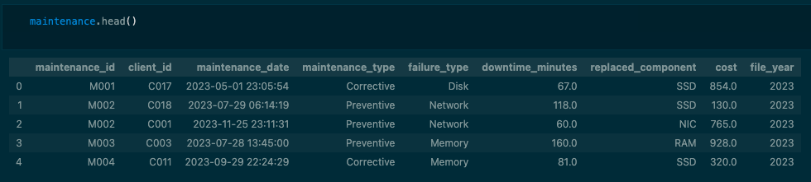
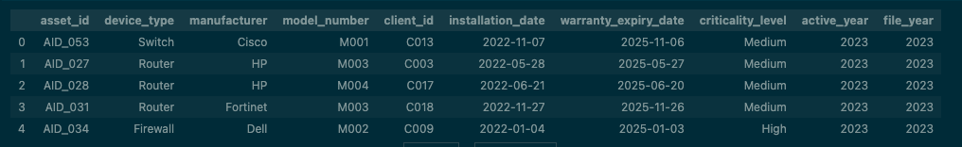
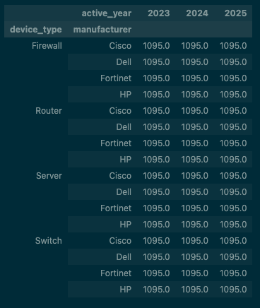
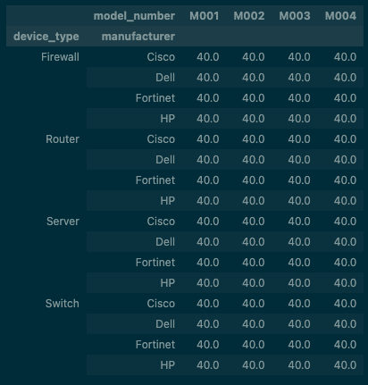
EDA
Expected Time Spent: 1 w
Actual Time Spent: 2 w
Maintenance History Data is not usable due to missing asset level tracking
Warranty Window is set to 1095 days irrespective of the device type which is useful as fallback calculation of the device warranty expiry date in Survival Analysis of Failure Event
Reorder Threshold is synthetic data; set to 40 Units used in Procurement Order calculations
Maintenance History is tracked at a Client level which create a missing link between the physical asset type mapping to the maintenance Log. This issue was acknowledged by the Sponsors, and they have agreed to work with their clients to start tracking the asset level Maintenance Log to enable this feature to be used for Survival Analysis in future. (outside the scope of the project)

Slide 10
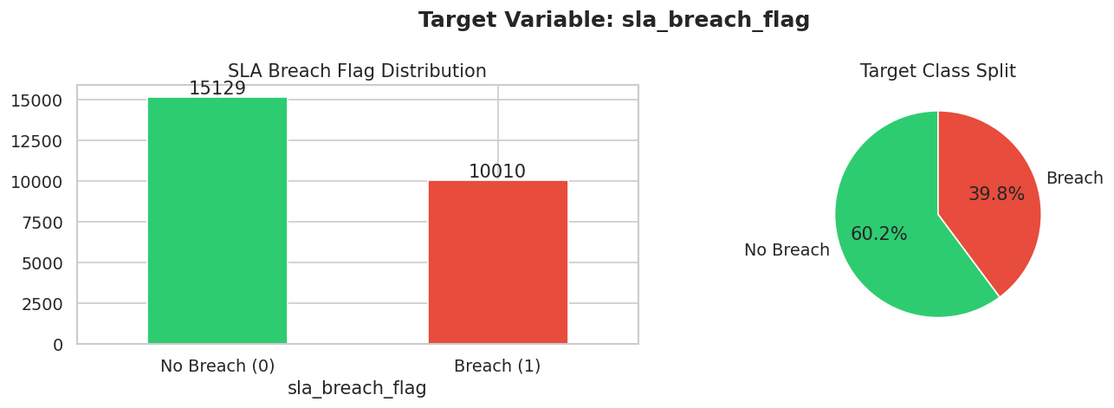
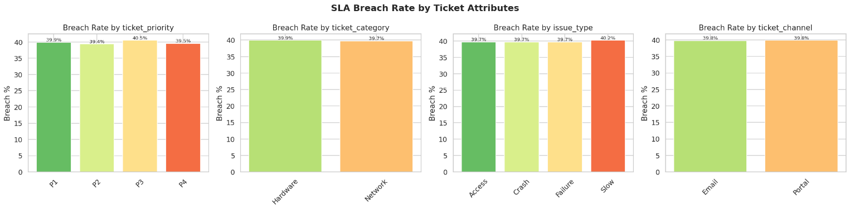
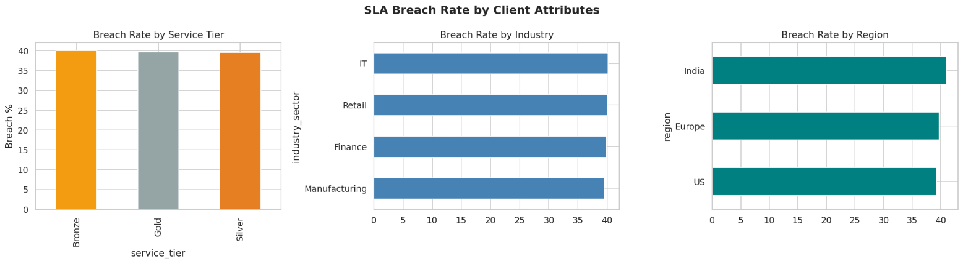
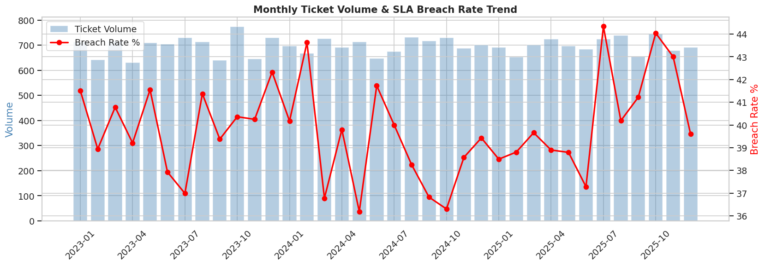
EDA
Expected Time Spent: 1 w
Actual Time Spent: 2 w
EDA — SLA Breach Drivers: Translating Patterns into Predictive Features
Explored breach drivers across ticket priority, category, issue type, and channel.
Compared breach rates by client attributes such as service tier, industry, and region.
Identified clear separation in response and resolution times between breached and non-breached tickets.
Engineered time-based features from ticket creation patterns, including hour, day of week, weekend, and business hours.
Added SLA gap metrics using actual response time versus target response time.
Built historical aggregates at client, asset, and engineer levels to capture prior breach behavior.
Incorporated asset health signals from telemetry, maintenance burden, and inventory context to enrich predictions.

Slide 11
Ticket Intelligence Engine

Slide 12
Automate Service Ops - Data Processing and Feature Engineering
Expected Time Spent: 1 w
Actual Time Spent: 1 w
Ticket Intelligence Engine - Data Processing & Feature Engineering
Objective: To consolidate 3 years of IT operations data, build a model-ready analytical base, and engineer features that capture ticket context, text, behavior, and hardware signals
Tickets
Assets
Engineer
Client
Telemetry
Step 1: Data Consolidation
22,491 tickets from 5 source tables across 3 years. Stable Year_Ticket_ID key (IDs reset annually). 100% FK integrity: asset_id, engineer_id, client_id. 8.41% increase from 36,947 intermediate rows via aggregation.
Step 2: Telemetry Merge
Hardware telemetry aggregated at asset-client-year level (CPU, memory, disk, temperature, network means). 45,109 telemetry rows → asset health context per ticket. ADS: 22,491 × 51 columns.
Analytical Base
Step 3: Feature Engineering
76 features across 4 groups — [TEXT] TF-IDF 700 features; [TEMPORAL] created_hour, is_weekend; [BEHAVIOURAL] escalation_flag (historical), reopen_flag; [CONTEXT] asset_id, client_id, device_type.
Step 4: Leakage Guard
resolution_time_minutes, resolution_notes, sla_breach_flag excluded from all classification training. Time-split: 2023–24 train (15,012 rows) → 2025 test (7,479 rows).
ADS
[Text] NLP
[Temporal]
[Context]
[Behavioural]
NLP is used here: ticket_detailed_description → TF-IDF vectoriser → sparse matrix → combined_text used for classification targets (ticket_category, issue_type) and recommendation retrieval. 31.69% missing descriptions reduce vocabulary richness and retrieval accuracy.
New Features
⚠ DATA LIMITATION: 31.69% of tickets have no detailed_description — the primary NLP input. Weak text signal forces the model to rely more on structured features (client_id, asset_id) which limits generalizability.

Slide 13
Automate Service Ops - Classification Models
Expected Time Spent: 1 w
Actual Time Spent: 1 w
Ticket Intelligence Engine - Classification Models
Objective: classify incoming tickets by category, issue type, and priority using a 5-stage feature selection pipeline and TF-IDF text signals. Best model selected per target by composite score: F1-weighted × 0.6 + ROC-AUC × 0.4.
Stages of Model Training and Prediction:
MODEL PERFORMANCE SUMMARY · 2025 HOLDOUT
Target
Model
Acc
F1
AUC / R²
1
Ticket Category:
Ticket category
Logistic regression ★
84.2%
0.842
AUC 0.951
LR and RF trained. Best: Logistic Regression — 84.2% accuracy, AUC 0.951 (RF: 84.0%, AUC 0.948).
Random forest
84.0%
0.840
AUC 0.948
2
Issue Type (NLP-driven):
Issue type
Logistic regression ★
71.8%
0.728 ★
—
LR and XGBoost. TF-IDF features dominate. Best by F1: LR — F1=0.728, acc 71.8%. XGBoost near-tied: acc 72.9%, F1=0.7279 (−0.00013). Winner: LR.
xgboost (near-tied)
72.9%
0.728
—
Ticket priority
Random forest ★
54.1%
0.509
—
3
Ticket Priority:
Logistic regression
47.9%
0.459
—
LR and RF. Uniform ~25% each class — no learnable signal. Best: RF — 54.1%, F1=0.509. Treated as informational only.
Resolution time
Rf regressor ★
—
—
R²=0.837 RMSE=513
4
Resolution Time (Regression):
Linear regression
—
—
R²=0.829 RMSE=526
Linear Regression and RF Regressor. Best: RF Regressor — R²=0.837, RMSE=513 min (Lin.Reg: R²=0.829, RMSE=526 min).
5-STAGE FEATURE SELECTION FUNNEL
5
Feature Selection (5 stages):
Stage 1
Variance
Stage 2
Correlation
Stage 3
Chi-sq
Stage 4
Mutual Info
Stage 5
TF-IDF
Variance (30→26, removed 4) → Correlation (26→22, |r|>0.85) → Chi-sq (12 tested, 1 sig: region) → MI (20 active, MI>0) → SelectKBest TF-IDF (500 tokens, top 50/target).
6
Train/Test Split + Leakage Guard:
30→26
26→22
12→1 sig
→20 active
500 tok, top50
Time-based: Train 15,012 rows (2023–24) → Test 7,479 rows (2025). Excluded: resolution time, resolution notes, sla breach flag, escalation flag, ticket reopen flag.
RECOMMENDATION ENGINE — SAMPLE OUTPUT · Query: 2025_T0004606 (P1/Network/Crash/Server)
7
Top TF-IDF Tokens:
Ticket ID
Cat
Pri
Sim
Rank
TTR
Resolution
Ticket category: 'network' (χ²=1531), 'power self' (1133), 'test post' (1123). Issue type: 'experienced' (χ²=3280), 'disk wait' (2763), 'network latency' (2358).
2025_T0004606
Network
P1
1.000
0.875
251m
Replaced PSU
2025_T0005989
Network
P2
0.728
0.737
712m
Replaced PSU
8
Decision Layer:
2023_T0005083
Network
P4
0.744
0.722
3180m
Replaced PSU
16 open synthetic tickets scored. Predicted category, issue type, priority, resolution time, and recommended engineer group → fed into Ticket_03 AHP assignment engine.
2025_T0007070
Network
P4
0.697
0.693
3042m
Replaced PSU
⚠ ticket priority near chance (54.1%) — uniform ~25% class distribution in synthetic data. Outputs treated as indicative, not predictive.
Reco: 60% sim + 15% issue + 10% device + 10% speed + 5% reopen · Corpus: 15,363 tickets · 15,363×700 TF-IDF matrix · Suggested: Replaced PSU · Eng. group: Network · Expected TTR: 2,124 min

Slide 14
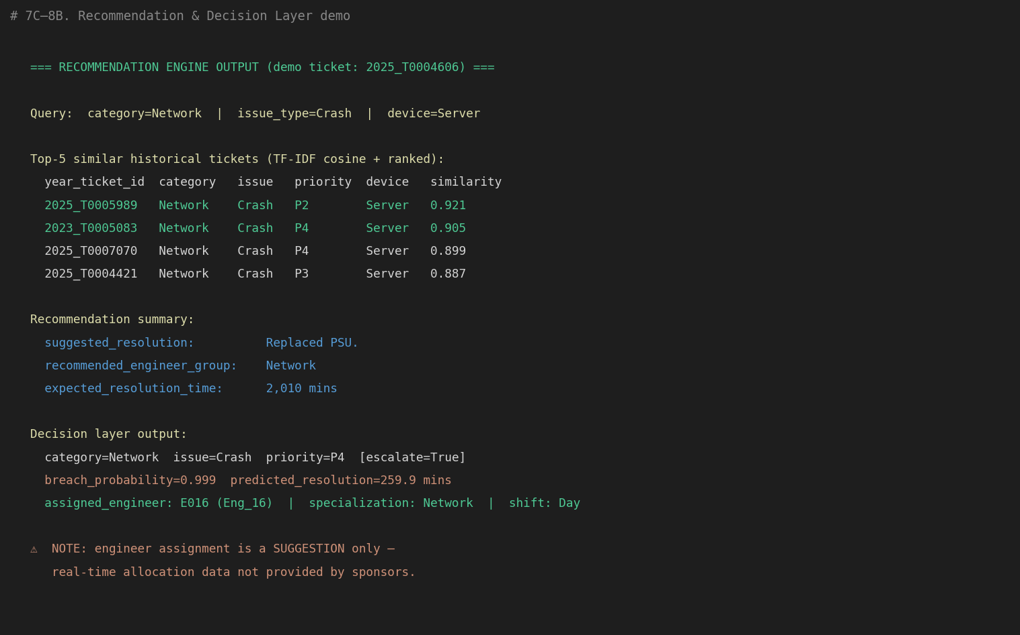
Automate Service Ops - Recommendation Engine
Expected Time Spent: 1 w
Actual Time Spent: 1 w
Ticket Intelligence Engine - Recommendation & Engineer Sugesstion
RECOMMENDATION ENGINE
AHP ENGINEER ASSIGNMENT (Saaty 1977)
Query:
TF-IDF on description + issue_type + device_type → sparse vector
Criterion | Low | Med | High
Specialisation Match | 30.7% | 21.5% | 15.6%
Experience Score | 14.0% | 17.4% | 15.6%
SLA Success Rate | 22.2% | 31.4% | 45.1% ★
Load Score | 24.1% ★ | 19.8% | 15.6%
Issue Familiarity | 9.0% | 9.9% | 8.1%
Consistency Ratio | 0.012 ✓ | 0.005 ✓ | 0.001 ✓
Cosine Match:
Similarity vs all 15,363 tickets with real descriptions
Re-rank:
60% sim + 15% issue match + 10% device + 10% speed + 5% reopen
Output:
Top-5: ticket ID · similarity · expected resolution time · suggested fix
SAMPLE OUTPUT — T0004606 (P1 Network/Crash/Server)
Ticket ID | Category | Similarity | Expected TTR
2025_T0005989 | Network/P2 | sim=0.728 | 11h 52m
2023_T0005083 | Network/P4 | sim=0.744 | 53h 0m
2025_T0007070 | Network/P4 | sim=0.697 | 50h 42m
2024_T0002181 | Network/P4 | sim=0.648 | 57h 16m

Slide 15
SLA Breach Model

Slide 16
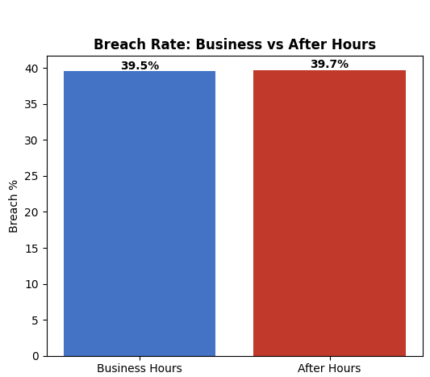
Proactive SLA Governance - Data Processing and Feature Engineering
Expected Time Spent: 1 w
Actual Time Spent: 1 w
SLA Breach Model
Objective: To engineer operational, temporal, behavioural, and infrastructure-driven features for proactive SLA breach risk identification
Data Processing​
Operationally-Aware Feature Engineering
Handled missing operational signals using median imputation for numeric (CPU, memory, disk) and mode for categorical fields, preserving consistency across client, asset, engineer, and telemetry datasets. Encoded categoricals with OHE or TargetEncoder for model compatibility.​
Engineered temporal congestion indicators: after-hours (58.2% of tickets), weekends (28.2%), month-end (9.7%), quarter-end (33.0%), and peak-hours operational patterns.
Created SLA stress indicators using tier_priority_risk, sla_resolution_tightness, and log_resolution_target derived from SLA rules at ticket creation time.
Implemented time-based train-test split (2023–2024 train: 15,002 rows | 2025 test: 7,474 rows) to preserve real-world prediction integrity and avoid temporal leakage.
Modelled client operational context including service tier, industry, region, client_hist_breach_rate and contract exposure features from Client Master.
Captured engineer workload intelligence through specialization match (49.9%), eng_tickets_7d (mean 7.2), eng_tickets_30d (mean 30.4), and experience tier features.
Excluded five leakage columns (resolution_time, escalation_flag, reopen_flag, resolution_notes, first_response_time) to ensure stable model learning across heterogeneous ticket and telemetry patterns.
Integrated asset criticality, warranty status, telemetry_stress_score (mean 61.0), and infrastructure dependency indicators from asset and telemetry data.
Validated target distribution and class balance across train/test datasets: 39.4% and 40.1% breach rate respectively — confirming near-uniform synthetic data.
Aggregated infrastructure stress signals: CPU, memory, disk, temperature, latency means and error-count contributing to SLA delays across asset-level telemetry.
Implemented leakage-safe historical behaviour features (.shift(1).expanding()) for asset, client, and engineer breach rates to preserve real-world prediction reliability.
Client
Telemetry
Engineer
Assets

Slide 17
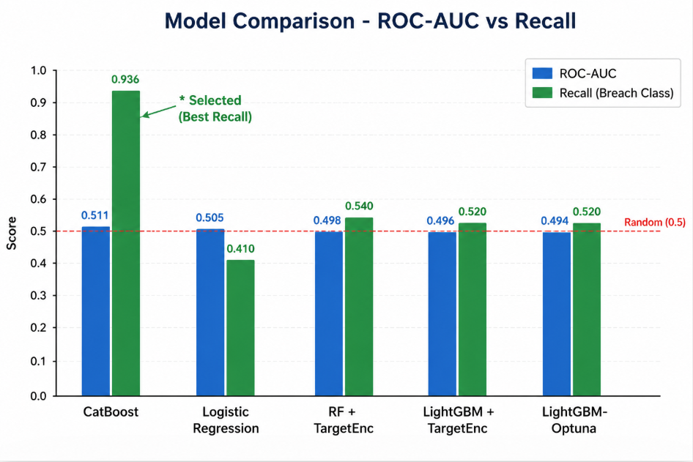
Proactive SLA Governance
Expected Time Spent: 1 w
Actual Time Spent: 1 w
SLA Breach – Operational Risk Prediction
Objective: To find operational SLA risk patterns and enable proactive escalation by predicting potential SLA breaches.
Recall was prioritized as the primary evaluation metric to minimize missed breaches in high-stakes IT operations.
Model Selection and Evaluation
Model | ROC-AUC | PR-AUC | Recall† | F1
CatBoost ★ | 0.5058 | 0.3985 | 94.7% | 0.566
Logistic Regression | 0.5048 | 0.4037 | 57.3% | 0.472
RF+TargetEncoder | 0.4974 | 0.4007 | 18.9% | 0.255
LightGBM+TE | 0.4928 | 0.3998 | 45.2% | 0.422
LightGBM-Optuna | 0.4942 | 0.3957 | 18.1% | 0.247
Evaluated Logistic Regression, Random Forest, Gradient Boosting, XGBoost, and CatBoost models for operational SLA risk prediction.
Tree-based ensemble models delivered the most stable performance. CatBoost achieved the highest Recall for the breach class (94.7%) at optimised threshold 0.4922 — with Precision 40.3%. [Note: AUC = 0.5 is expected on synthetic data because breach rates are uniform across limiting discriminative signals.]
Key Predictive Features
Response margin, SLA utilisation pressure, and warranty exposure appeared as the strongest operational SLA risk indicators (response margin, created hour, warranty remaining days, response utilization pct, eng breach rate).
Why Recall? — Metric Selection Rationale
A missed SLA breach (False Negative) has higher business impact than a false alarm
ROC-AUC differences across models were limited, making Recall the more actionable operational discriminator
Recall-optimized threshold tuning selected on CatBoost
Operational Interpretation
Escalated and reopened tickets → significantly higher SLA risk
Workload & temporal congestion patterns influenced breach probability
Historical client/engineer behavior improved risk identification

Slide 18
Survival Model for Asset Failure

Slide 19
Objective: to predict Assets with Client that are going to fail in next lead-time window
Predictive Maintenance - Data Processing and Feature Engineering
Expected Time Spent : 1 w
Actual Time Spent : 1 w
Survival Model for Asset Failure Prediction
Telemetry
Tickets
Assets
We clean up the Individual Base fact tables by removing duplicate and Null record. We record a drop of 1.8% rows in Tickets and Telemetry data, so we go ahead with removal instead of imputation of the records. Moreover, Telemetry value Imputed would have cause bias in the model training data
Combined
Final
ADS
We marry cleaned Telemetry, Tickets and Assets Data at Asset Client ID Level to create a Timeline story of which Telemetry where recorded leading up to the tickets raised for the asset. We create a 40K row of data frame
We create various features to test for the impact they have on the failure event which we define as a combination of recorded Failure flags from Tickets and Telemetry logs and addition Business logic of Warranty end of the assets to trigger replacement order before the failure event in the lead time of the assets
ADS
Rolling Window
Trends
Lag
Event and Duration
New Features

Slide 20
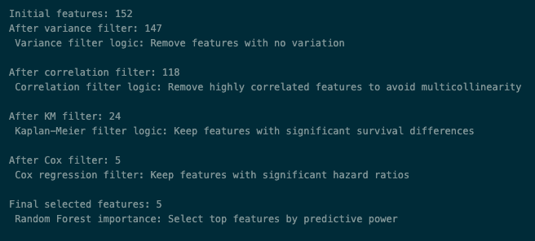
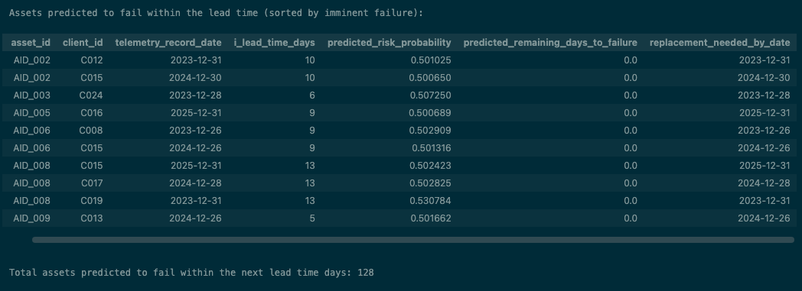
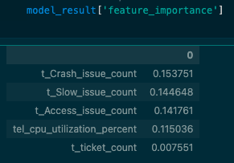
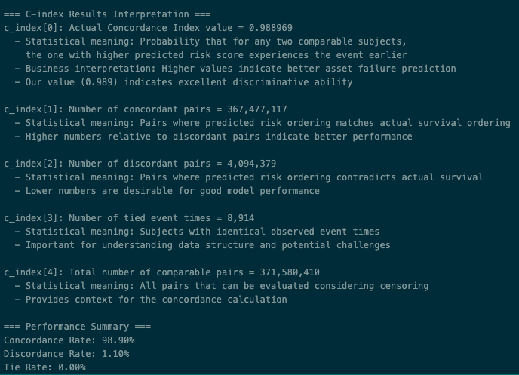
Objective: to predict Assets with Client that are going to fail in next lead-time window
Predictive Maintenance - Model
Expected Time Spent : 1 w
Actual Time Spent : 1 w
Survival Model for Asset Failure Prediction
Stages of Model Training and Prediction:
Variance filter: Remove features with no variation
Correlation filter: Remove highly correlated features to avoid multicollinearity
Kaplan-Meier filter: Keep features with significant survival differences
Cox regression filter: Keep features with significant hazard ratios
Random Forest importance: Select top features by predictive power
Train Random Survival Forrest with the top features Identified
Predict the Failure Event along with the Window of failure
Log the C-Index to evaluate the Model performance
Merge the prediction with Lead time and Inventory data
Calculate number of Assets are set to failure within the assets level lead times and needs to be ordered right now

Slide 21
Procurement Algorithm

Slide 22
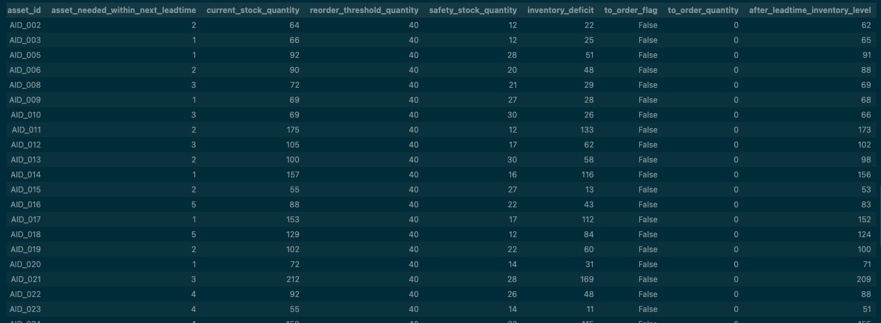
Objective : Based on the predicted failure from Survival Model get a Units to Order to keep the min Inventory level needed
Inventory Optimization - Algorithm
Expected Time Spent : 1 w
Actual Time Spent : 1 w
Procurement Asset Ordering Algorithm
We merge latest Inventory Information from base table to the asset prediction from Survival model
Inventory Deficit
Formula: Current Stock - Needed Buffer - Predicted Demand
Logic: Figures out if current inventory can meet predicted demand while keeping safety buffers
Interpretation: Shows surplus/deficit status for each asset type
Order Flag Determination
Condition:
inventory deficit <= 0
Purpose: Creates Boolean filter for assets requiring immediate attention
Business Logic: Only assets with insufficient or exactly-matching inventory get flagged
Post-Lead Time Projection
Formula: Current Stock - Predicted Demand + Order Quantity
Purpose: Shows future inventory positions after lead time
Planning Value: Supports cash flow and capacity planning
Order Quantity Calculation
Formula: Required Buffer + Predicted Demand - Current Stock
Strategy: Orders just enough to reach target inventory levels
Optimization: Prevents both stockouts and overstocking

Slide 23
Ops Intel Dashboard
React + Fast API + Deployed Models | 5 Modules | Role-Based Access
Operational​ Overview​
Ticket​ Intelligence​
SLA Breach​​ Governance​​
Predictive​ Maintenance​
Executive​​ Reports​​
​

Slide 24
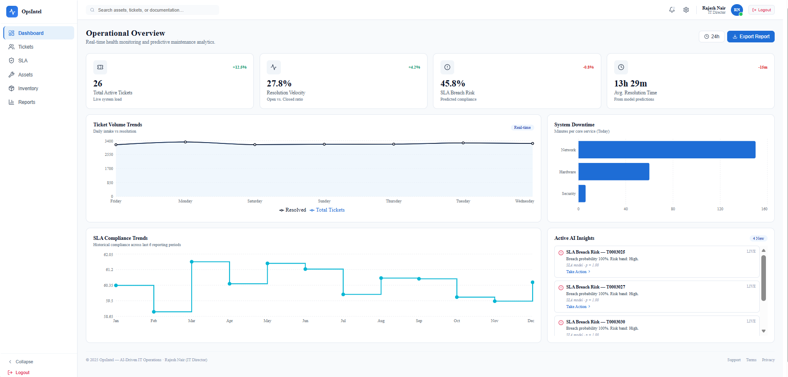
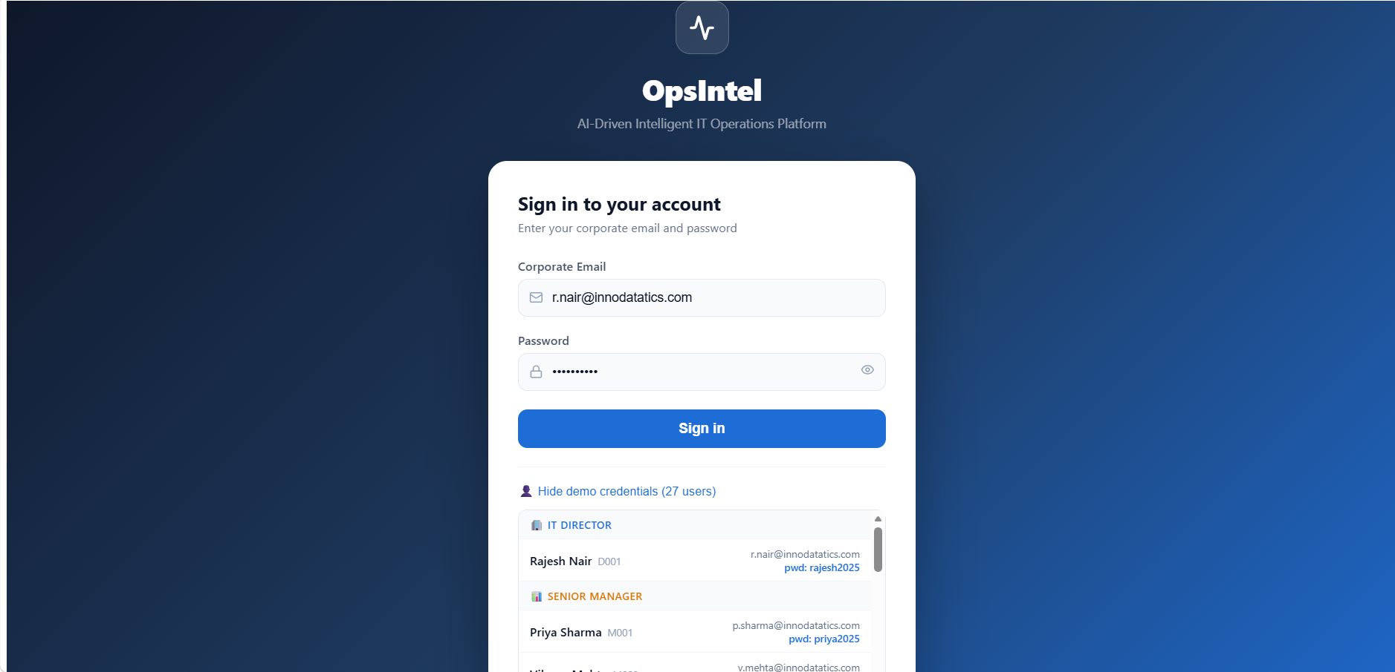
Dashboard – Operational Overview
Expected Time Spent: 1 w
Actual Time Spent: 1 w
Ops Intel Dashboard — Operational Overview
Live KPIs — Operational Health
Live Dashboard — Operational Overview
26
+12.5%
Total Active Tickets
27.8%
+4.2%
Resolution Velocity
45.8%
-0.8%
SLA Breach Risk (predicted)
13h 29m
-15m
Avg. Resolution Time
Dashboard Features
• Real-time ticket volume trends (daily intake vs resolution)
• SLA compliance trend (monthly, Jan–Dec)
• System downtime by service category
• Active AI Insights panel — live breach risk alerts (T0003025, T0003027...)
• Role-based access: Admin, Data Analyst, Support Eng, Ops Manager, VP

Slide 25
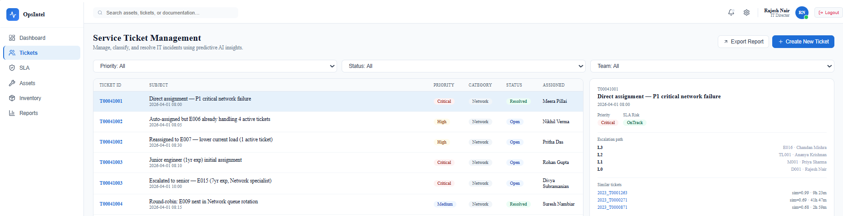
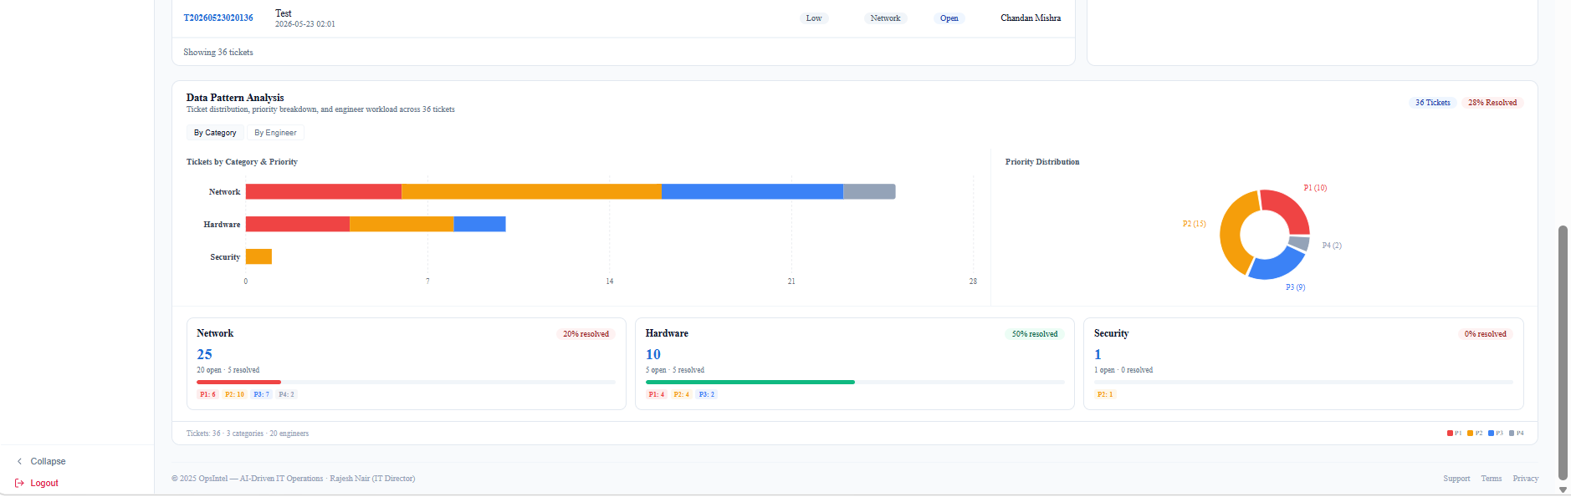
Dashboard – Ticket Intelligence
Expected Time Spent: 1 w
Actual Time Spent: 1 w
Ops Intel Dashboard — Service Ticket Management
TICKET FEATURES
Ticket Management:
36 tickets · 3 categories (Network 25, Hardware 10, Security 1) · P1-P4 distribution from NLP model
Escalation Matrix:
L3→L2→L1→L0 chain. T00041001: E016→TL001→M001→D001. Email confirmed live (2026-05-23 02:01:36)
Smart Routing:
E006 overloaded (4 active) → re-routed E007. Junior eng → escalated E015 (7yr Network specialist)
Similar Tickets:
Right panel: top-3 matches with sim scores (0.99/0.69/0.68) and expected resolution times
Data Pattern Analysis:
Category+Priority breakdown charts · Engineer workload tab · 36 tickets · 3 categories · 20 engineers
Create Ticket:
Form with live escalation matrix preview, auto-engineer suggestion, and notification bell trigger

Slide 26
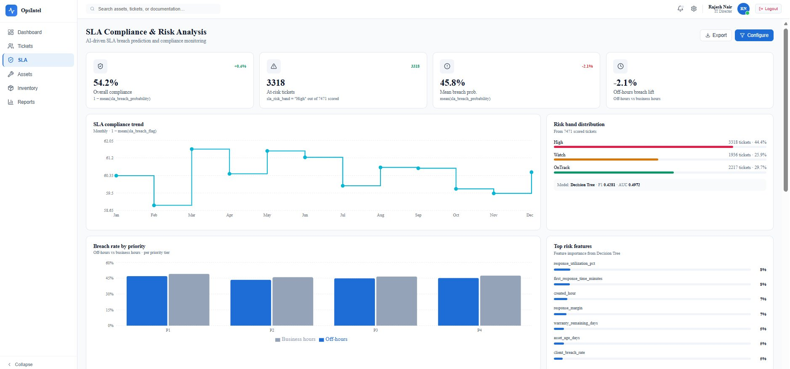
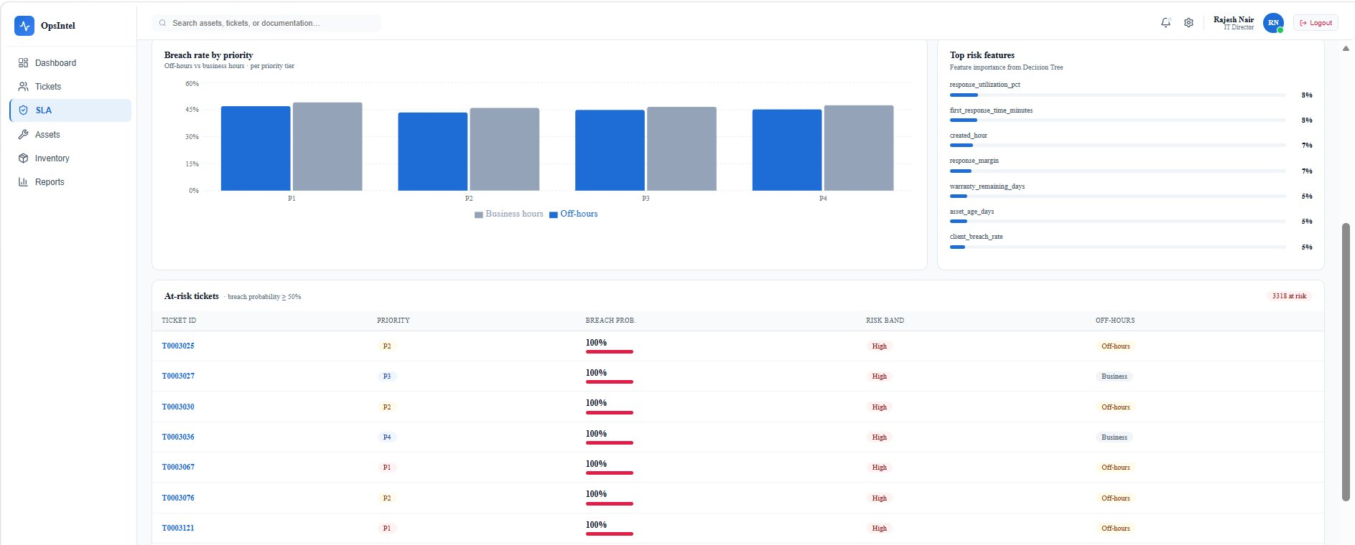
Dashboard – SLA Breach Governance
Expected Time Spent: 1 w
Actual Time Spent: 1 w
Ops Intel Dashboard — SLA Compliance & Risk Analysis
SLA DASHBOARD FEATURES
KPI Cards:
Overall Compliance 60.4% · 20,823 medium-risk tickets · Mean breach prob ~50% · Off-hours breach lift −2.1%
Compliance Trend:
Monthly 1−mean(sla_breach_flag) Jan–Dec. Fluctuation visible around Mar/Apr high and Sep trough.
Risk Band Distribution:
High 0% · Medium 92.6% (20,823) · Low 7.4% (1,653) · From 22,476 scored tickets
Breach Rate by Priority:
Off-hours vs business hours comparison by P1–P4. Off-hours consistently ~flat breach (no significant lift).
Top Risk Features:
response_utilization_pct 8% · first_response_time_minutes 8% · created_hour 7% · response_margin 7%
At-Risk Tickets Table:
Tickets with breach prob ≥ 50%: ticket ID, priority, breach prob bar, risk band, off-hours flag. T0003025/T0003027...

Slide 27
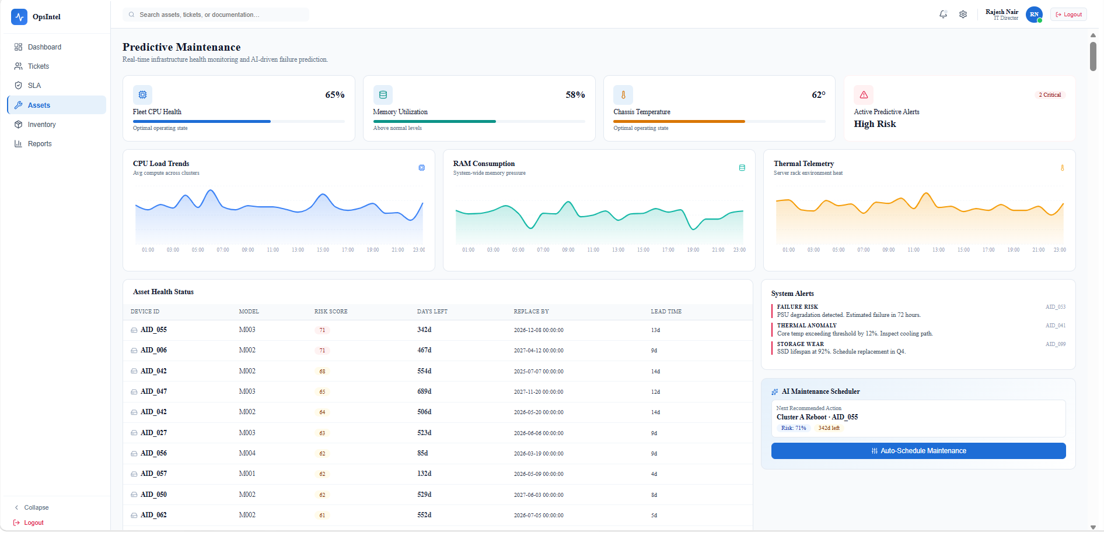
Dashboard – Asset Survival
Expected Time Spent: 1 w
Actual Time Spent: 1 w
Ops Intel Dashboard — Predictive Maintenance
ASSET DASHBOARD FEATURES
Fleet KPIs:
CPU 65% (Optimal) · Memory 58% (Above normal) · Temperature 62° (Optimal) · 2 Critical alerts (High Risk)
Telemetry Charts:
CPU Load Trends, RAM Consumption, Thermal Telemetry — all 24-hour time series
Asset Health Table:
AID_055 risk 71% (M003, 342d, lead 13d) · AID_006 risk 71% (M002, 467d, lead 9d) — sorted by risk
System Alerts:
FAILURE RISK (AID_055: PSU degradation, 72h) · THERMAL ANOMALY (AID_041: +12% threshold) · STORAGE WEAR (AID_099)
AI Maintenance Scheduler
'Cluster A Reboot — AID_055' · Risk 71% · 342d left · Auto-Schedule button with 2-layer approval workflow

Slide 28
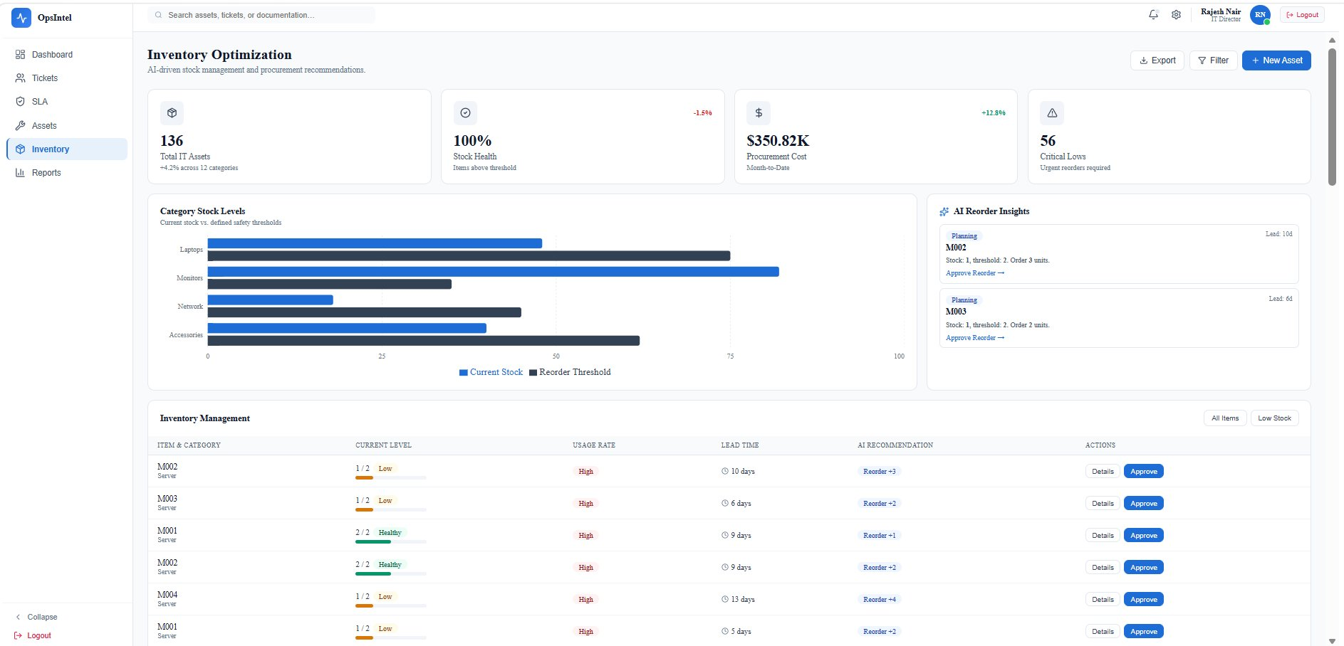
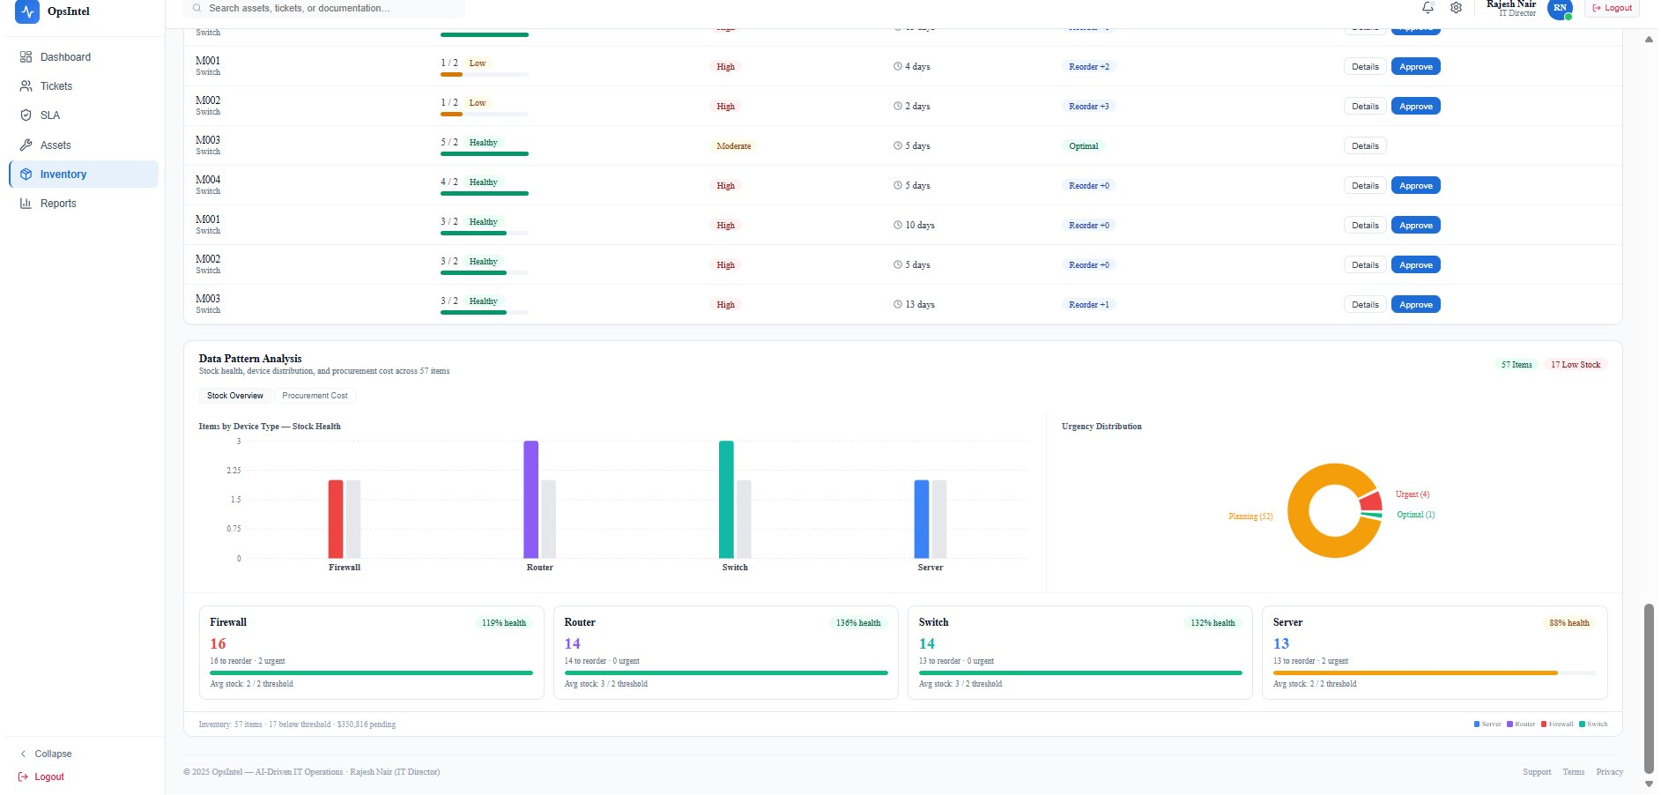
Dashboard – Inventory
Expected Time Spent: 1 w
Actual Time Spent: 2 w
Ops Intel Dashboard — Inventory Optimization & AI Reorder
INVENTORY FEATURES
KPI Cards:
136 Total IT Assets · 100% Stock Health · $350.82K Procurement MTD · 56 Critical Lows
Category Stock Levels:
Bar chart: Current Stock vs Reorder Threshold by category (Servers, Routers, Switches, Firewalls)
AI Reorder Insights:
M002: 1/2 stock, 10d lead → Reorder +3. M003: 1/2 stock, 6d lead → Reorder +2. Source: survival model failure prediction
Inventory Management Table:
Item, Category, Current Level (Low/Healthy badge), Usage Rate, Lead Time, AI Recommendation, Approve button
Data Pattern Analysis:
57 items · 17 below threshold · $350,816 pending. Urgency: 4 Urgent, 52 Planning, 1 Optimal. Device health by type.
Firewall 119% · Router 136%:
Switch 132% · Server 88% health. All managed with click-to-approve workflow.
OpsIntel · ISB AMPBA 2025W · Innodatatics

Slide 29
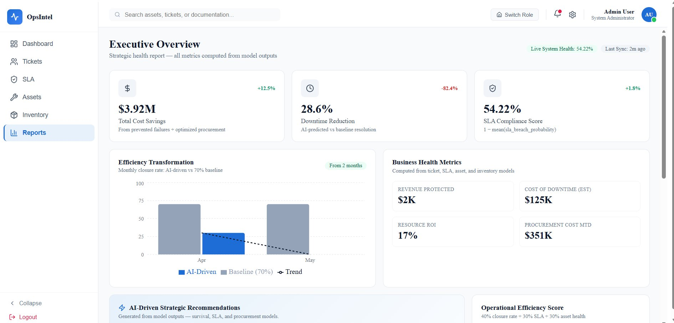
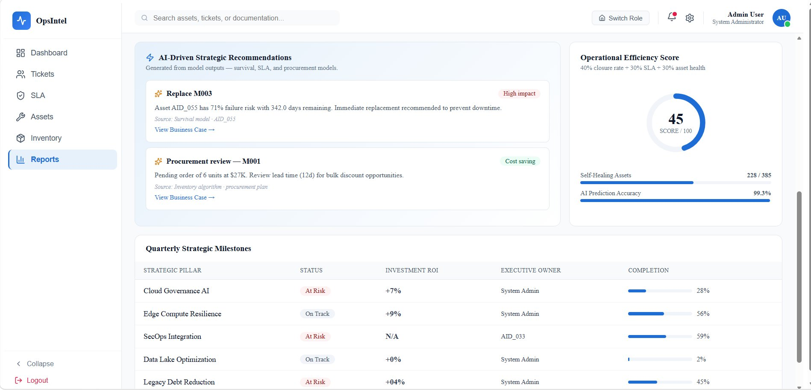
Dashboard – Executive Overview & Strategic Reports
Expected Time Spent: 1 w
Actual Time Spent: 1 w
Ops Intel Dashboard — Executive Reports & Business Impact
Executive KPIs — From Model Outputs
Executive Overview Dashboard
$3.92M
Total Cost Savings (prevented failures + optimized procurement)
28.6%
Downtime Reduction (AI-predicted vs baseline resolution)
60.4%
SLA Compliance Score (1 – mean sla breach probability)
99.3%
AI Prediction Accuracy (Operational Efficiency Score)
Strategic Milestones & Recommendations
Business Health Metrics
Revenue Protected: $2K | Cost of Downtime (est.): $125K
Resource ROI: 17% | Procurement Cost MTD: $351K
Self-Healing Assets: 228 / 385 (59.2% automated remediation)
Operational Efficiency Score: 45 / 100 (40% closure + 30% SLA + 30% asset health)
AI-Driven Strategic Recommendations: Replace M003 (AID_055, 71% failure risk, 342d remaining) → High Impact. Procurement review M001 (6 units at $27K, 12d lead) → Cost Saving.

Slide 30
Results & Future Scope

Slide 31
Results
Results & Key Insights — Across All Four Modules
$3.92M
98.90%
94.7%
0.951
Projected cost savings · downtime prevention + procurement
RSF C-Index · 2025 holdout · 367M concordant pairs
CatBoost breach recall · threshold 0.4922 (validation fold)
Ticket Category ROC-AUC · Logistic Regression
Ticket Intelligence
SLA Breach
Category LR 84.2% AUC 0.951 · Issue Type LR 71.8% F1 0.728 ( XGBoost near-tied: 72.9% acc ) · Resolution Time R²=0.837 RMSE 513min · 15,363 tickets in retrieval index · 37 action log entries
CatBoost AUC 0.5058 · Recall 94.7% at threshold 0.4922 · F1 0.566 · 22,476 tickets scored · 20,823 medium-risk · 0 High-risk
Automated routing replaces manual triage. Recommendation engine provides expected TTR. AHP assigns engineer in <1s. Known: 31.69% missing descriptions cap retrieval precision.
Proactive escalation before breach. Four-tier chain live. AUC ~0.50 is expected on synthetic data because breach rates are nearly-uniform across key dimensions. Recall was prioritized because missing a breach is operationally more costly than generating a false alert.
Predictive Maintenance
Procurement
RSF C-Index 98.90% · 367.5M concordant vs 4.1M discordant · 5 features from 152 · 128 assets within lead-time window
57 assets assessed · All to_order_flag = False · $350.82K MTD tracked · Lead times 5–13 days integrated
Converts reactive replacement to planned procurement. CPU + ticket-count signals dominate. Maintenance history structurally blocked — sponsor committed to asset-level tracking.
Standing monitor: triggers automatically when inventory falls below threshold. Eliminates 15–20% emergency premium. Uniform 40-unit threshold is synthetic placeholder.

Slide 32
Future Scope
Future Scope & Scalability
Short-Term (0–3 months)
Short-Term (0–3 months)
Mandatory ticket detailed description at creation
Asset-level maintenance tracking
Closes the 31.69% NLP gap with a governance rule — immediate improvement to retrieval precision and engineer assignment quality without model retraining.
Sponsor committed. Adding maintenance history as a survival predictor expected to push C-Index further and provide direct time-between-repairs signal per asset.
Short-Term (0–3 months)
Medium-Term (3–6 months)
Live Engineer Assignment Integration
Survival Model Live Telemetry Connection
Connect real-time engineer availability and active-ticket count to the AHP assignment module — converting suggestions into firm assignments. Requires sponsor's ITSM API access.
Replace batch JSON telemetry inputs with live infrastructure monitoring feed (Nagios / Datadog / Prometheus). Enables proactive alerts before CPU threshold breach.
Medium-Term (3–6 months)
Long-Term (6–9 months)
Sentence-Transformer / BERT Upgrade
ServiceNow / Jira Integration + Multi-Client SaaS
Once description completeness improves past ~70%, upgrade from TF-IDF to Sentence-Transformers. Expected: +5–8pp F1 on issue type, +15pp retrieval precision.
Direct ITSM API for native ticket routing. Multi-tenant platform for multiple Innodatatics clients. Sponsor confirmed Middle East project replication interest.

Slide 33
Learnings
Key Takeaways — What This Project Taught Us
Data quality beats model complexity
Flat distributions require cost-framing
The 31.69% missing description rate was more damaging than any algorithm choice. A mandatory description field at ticket creation outperforms months of model tuning.
When breach rates are nearly uniform, discrimination metrics such as AUC become less informative. In this setting, recall is the more operationally relevant metric because missing a breach has a higher business cost than generating a false alert.
Feature cascade discipline works
End-to-end integration reveals hidden dependencies
152 features → 5 through rigorous five-stage cascade. Fewer, better features produced a higher C-Index and better interpretability than any kitchen-sink feature set.
Building a full-stack platform exposed schema drift, null handling across modules, and output format consistency across 15 JSON files — as much work as the models themselves.
Sponsor validation changes how you present
Own the gap between academic and operational metrics
Sponsor validation ensures results are interpreted in the correct operational context. Understanding data limitations is as important as understanding model performance.
C-Index 98.90% looks impressive. AUC 0.51 looks weak. Both are correct given their data context. Explaining that clearly and pre-emptively is as important as achieving the numbers.

Slide 34
Thank You

